Slide 1
Design and Control of the BlueFoot Platform:
A Multi-terrain Quadruped Robot
Brian Cairl
Dr. Farshad Khorrami
May 13, 2015

Slide 2
Overview
Introduction
Hardware and Design
Software Architecture
System Modeling
Gait and Stability Control
Navigation Control
Concluding Remarks

Slide 3
Quadruped Robotics
Inspired by notable quadruped robotic systems from the past decade:
LittleDog (Boston Dynamics)
BigDog (Boston Dynamics)
Tekken (Kyoto Institute of Technology)
Kolt (Stanford University)
HyQ (Istituto Italiano di Tecnologia)

Slide 4
Quadruped Robotics
Well known advantages over wheeled robots, mainly in adaptability to terrain
At the follows expenses:
Higher power consumption (more actuators)
Lower payload capacity (higher actuator loading)

Slide 5
Quadruped Robotics
Applications
Gaiting design/research
Rough-terrain navigation/planning
Toward:
Disaster recovery
Search and rescue
Environmental mapping

Slide 6
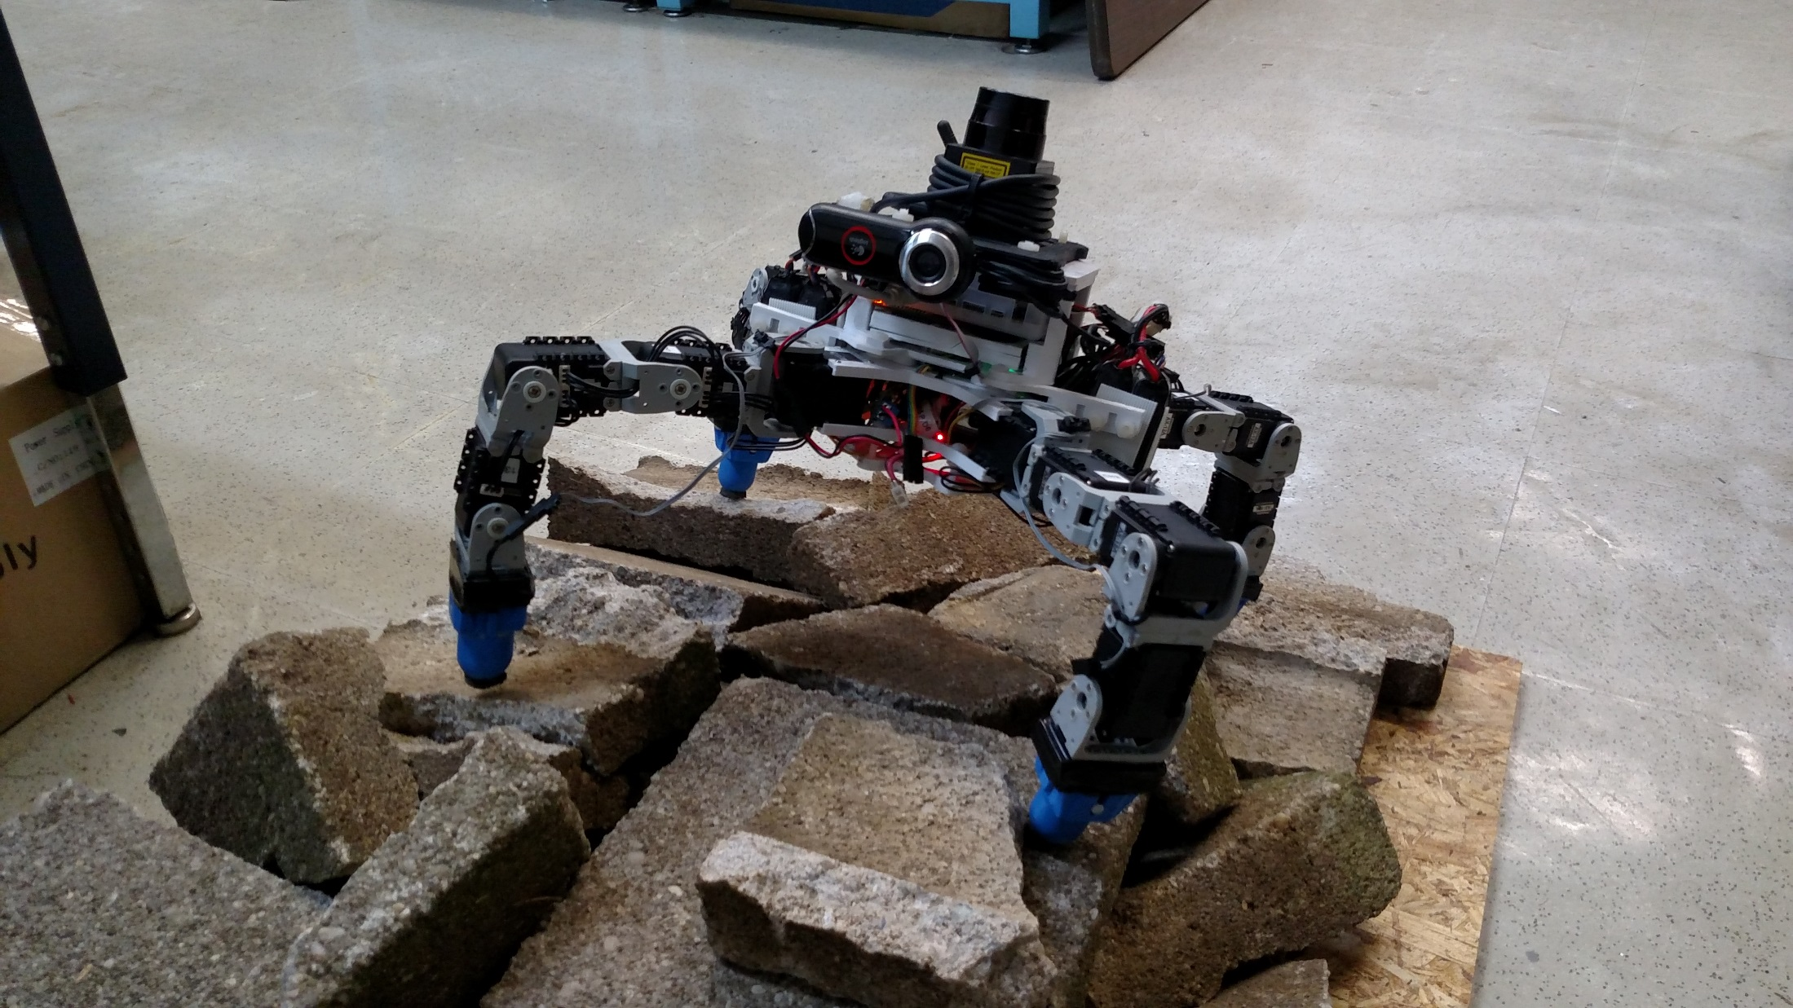
The BlueFoot Platform

Slide 7
The BlueFoot Platform, cont.
Small-scale quadruped robot
16 actuated degrees of freedom
High Dexterity:
Stabilization and repositioning on variable terrain
Large range of trunk articulation
Ability to overcome raised/uneven terrain

Slide 8
Overview of Control Strategies
Central Pattern Generator (CPG)-based gait control
Zero-Moment Point (ZMP) body posture control
Virtual-Force foothold controller
NARX-Neural Network based trunk-leveling controller

Slide 9
Overview of Control Strategies, cont.
Potential-Fields/Visual-Servoing control
Surface Reconstruction for rough terrain navigation
3D Point clouds from 2D LIDAR scans
Height-map Generation
Surface Estimation
Rough terrain planning using Height-maps

Slide 10
Design Overview
Modularity between body segments
Robot consists of 3 main sections
3D printed structural components
Lightweight
Rapid design iterations
Facilitates modular design

Slide 11
Core Devices
AutoPilot
TM4C 80 MHz
RM48 220 MHz
IMU
Magnetometer
Pressure/Humidity Sensor
GPS
Dynamixel Serial Servos
Foot Contact Sensors
ODROID-XU Computer
Camera
LIDAR

Slide 12
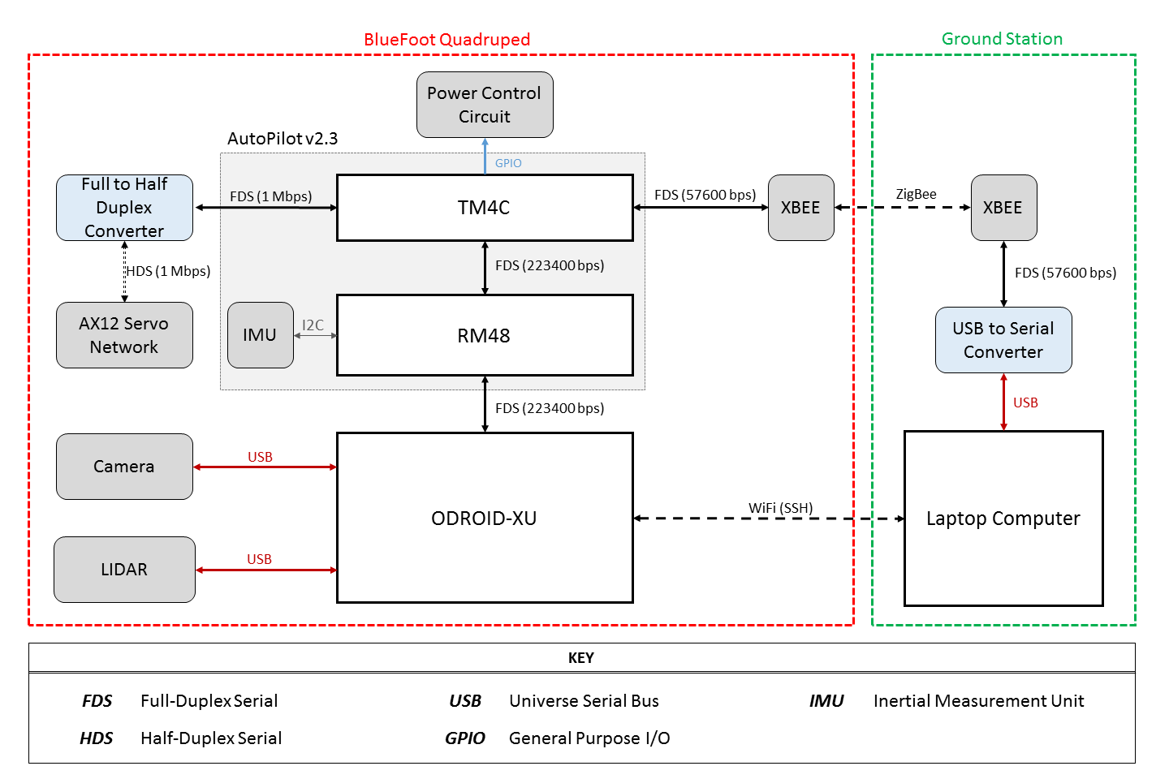
Design: Device Association

Slide 13
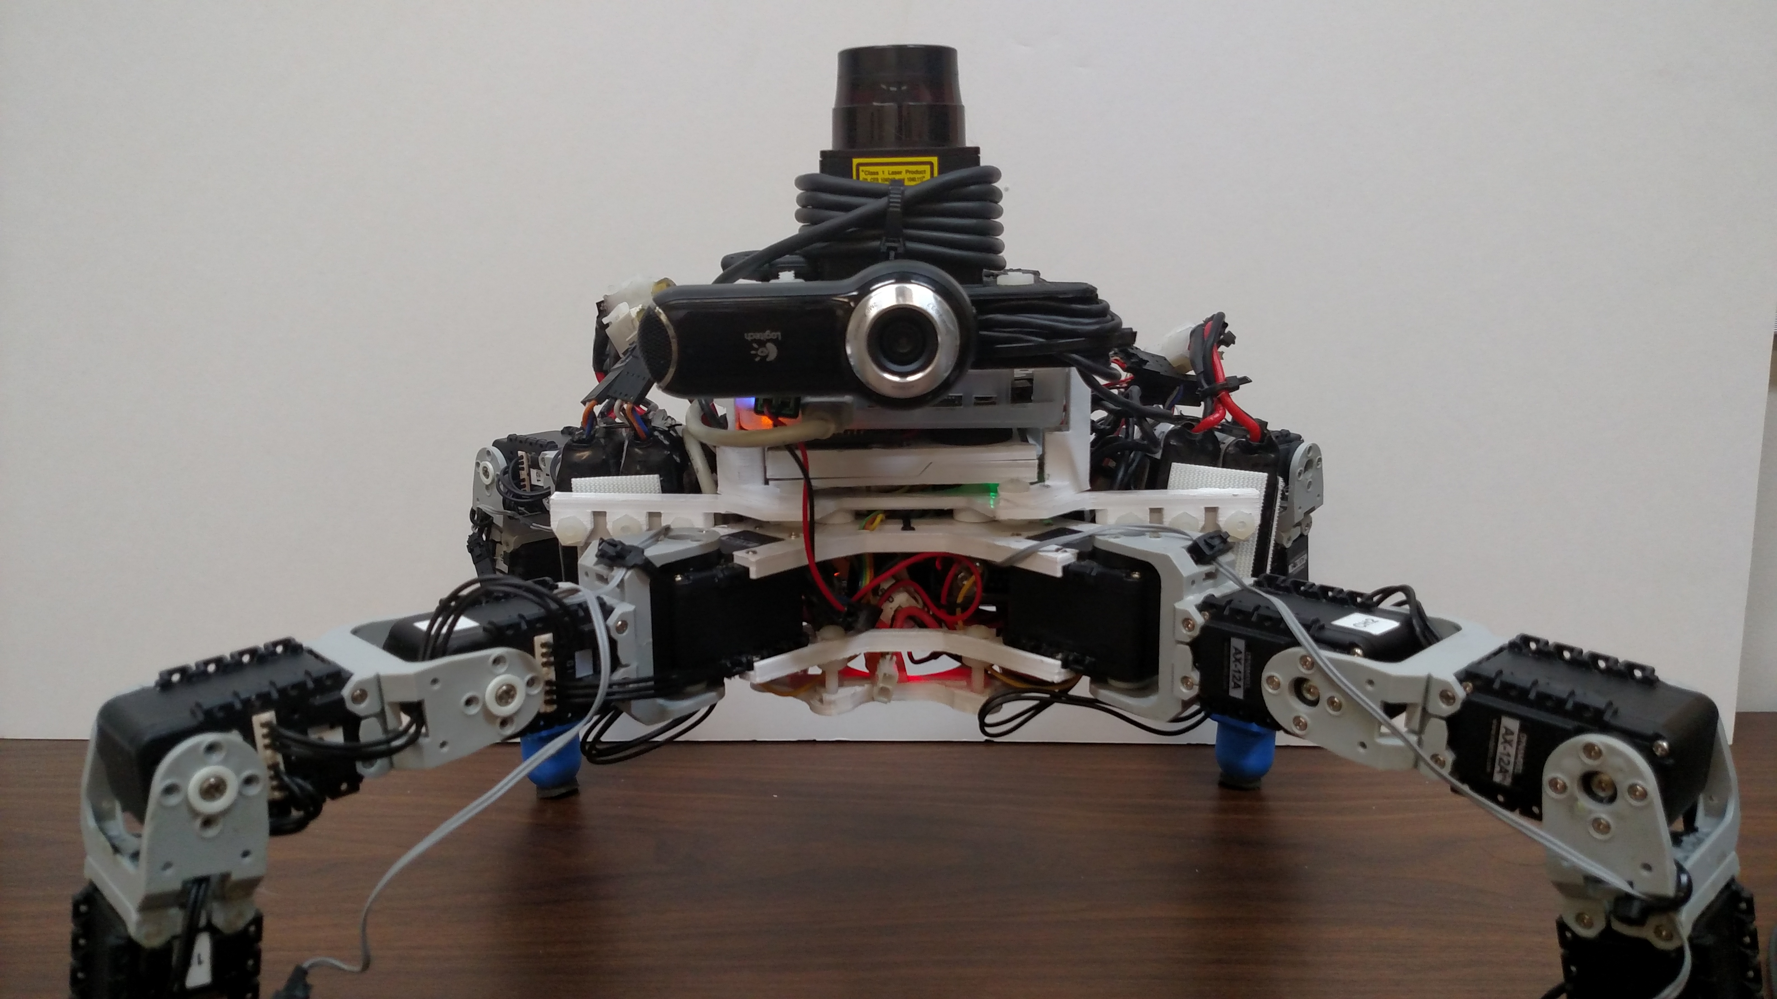
Design: Layout

Slide 14
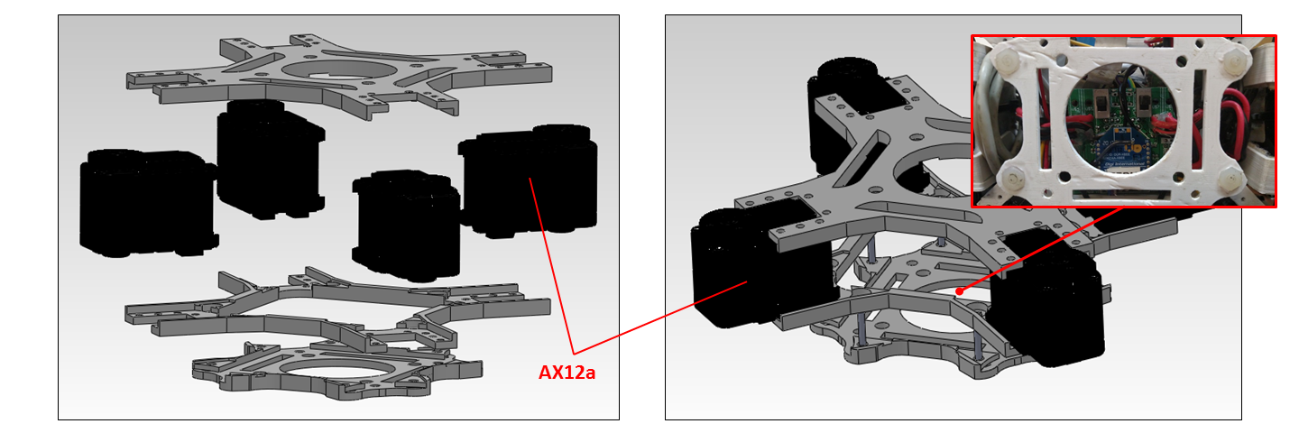
Design: Lower Body (Root Module)

Slide 15
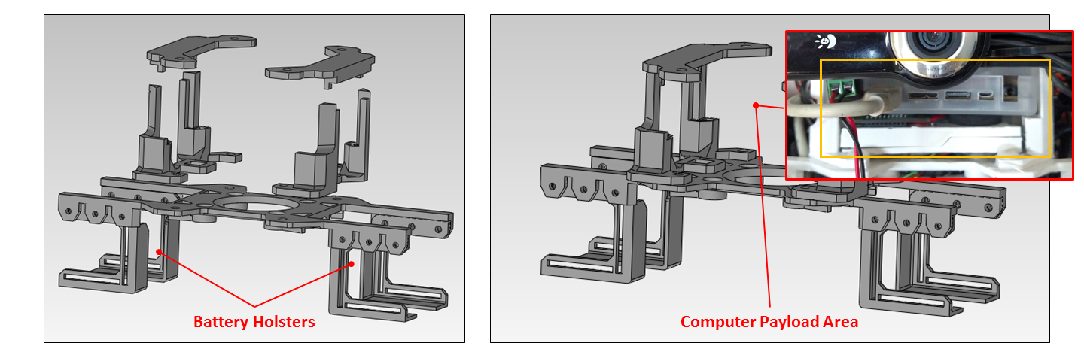
Design: Mid Body (Main Module)

Slide 16
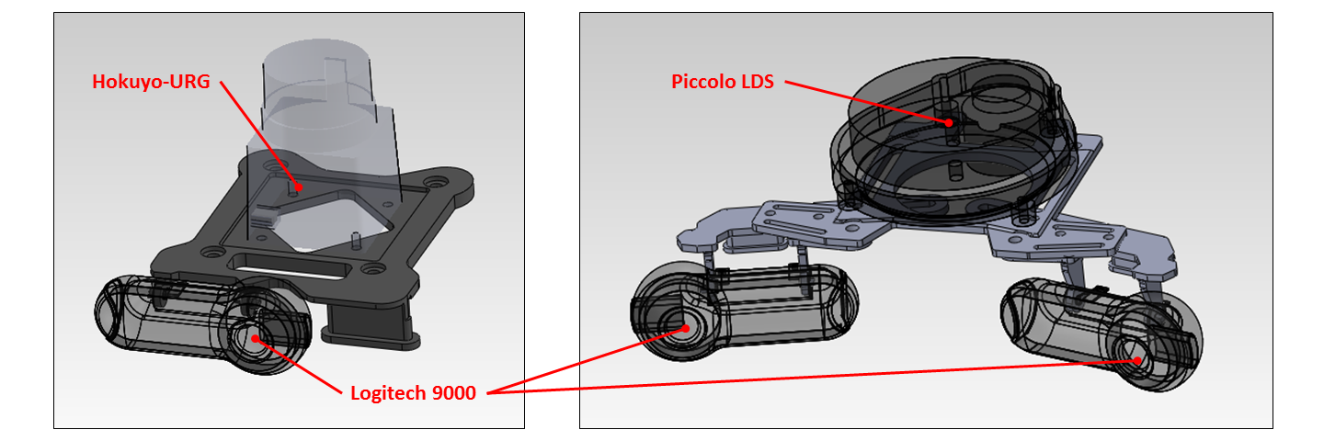
Design: Upper Body (Head Module)

Slide 17
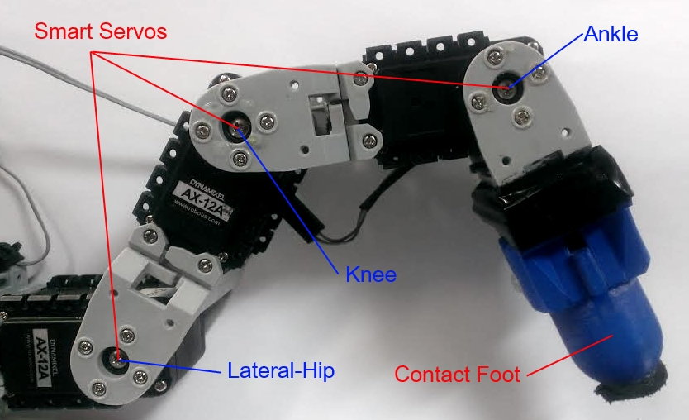
Design: Legs

Slide 18
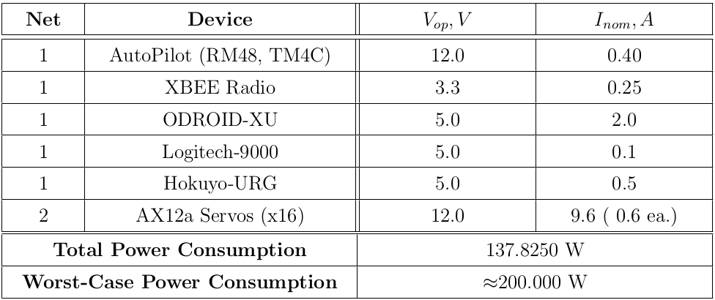
Design: Power Requirements

Slide 19
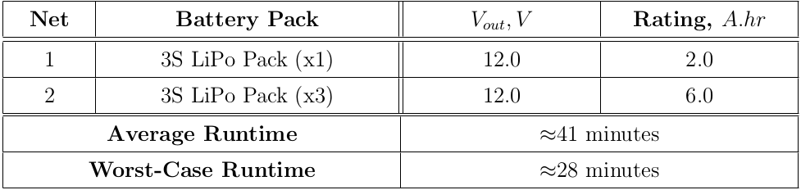
Design: Power Capacity and Run-time

Slide 20
Software: Overview

Slide 21
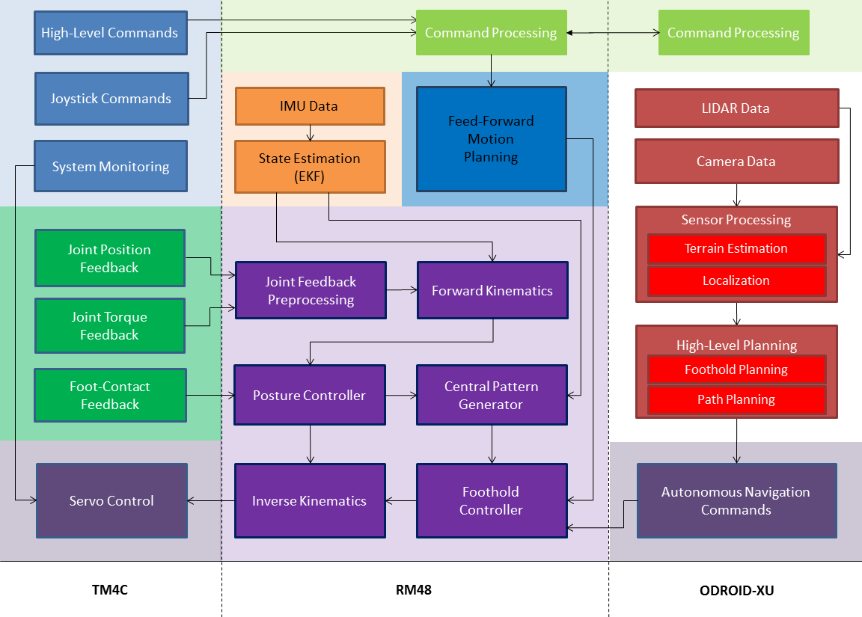

Slide 22
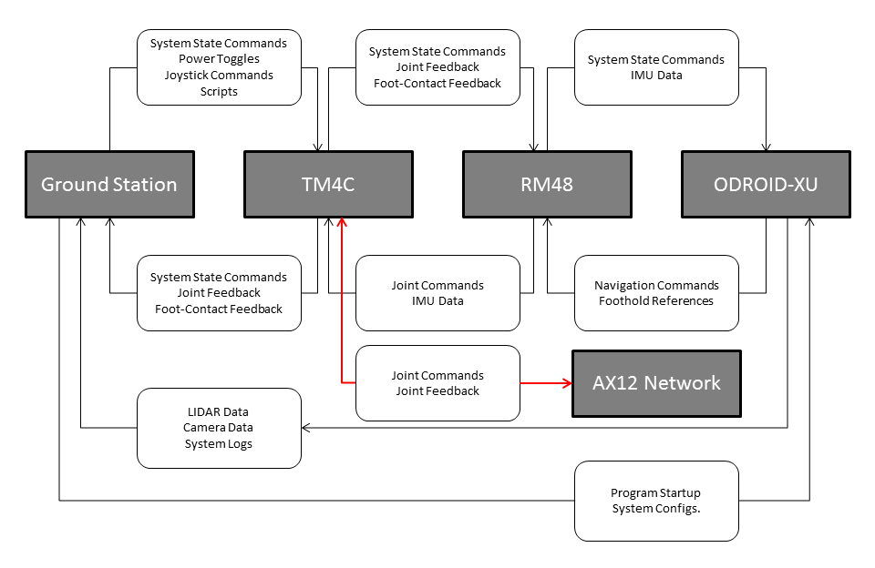

Slide 23
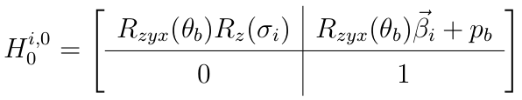
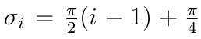
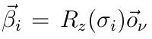
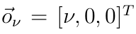
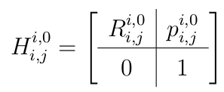
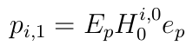
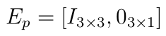
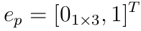
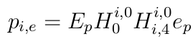
Position Kinematics

Slide 24
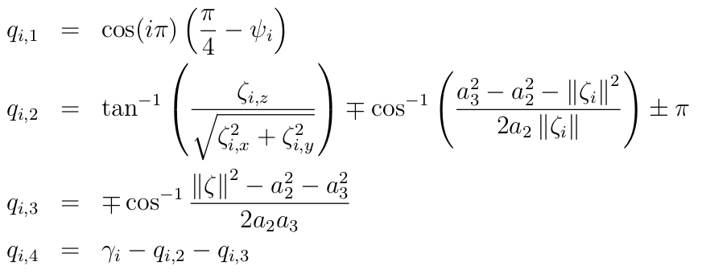
Inverse Position Kinematics

Slide 25
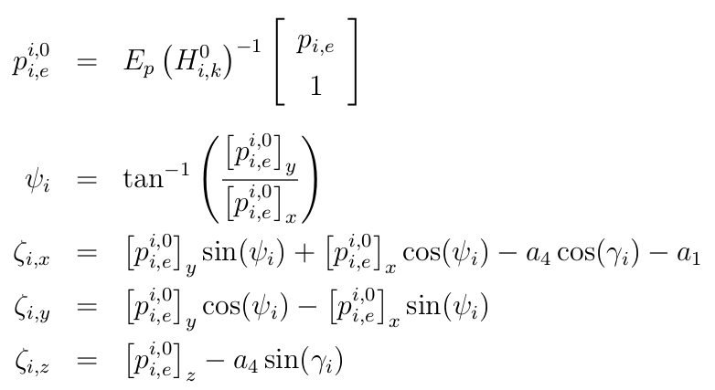
Inverse Position Kinematics, cont.

Slide 26
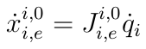
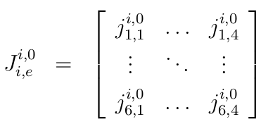
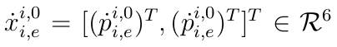
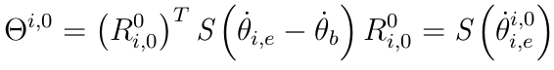
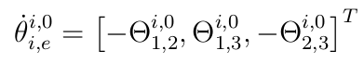
Velocity Kinematics

Slide 27
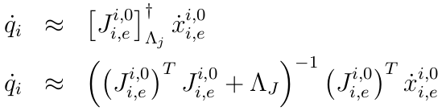
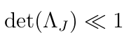
Inverse Velocity Kinematics

Slide 28
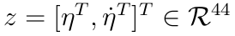
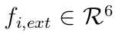
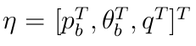
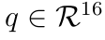
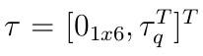
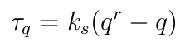
Dynamical Model

Slide 29
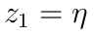
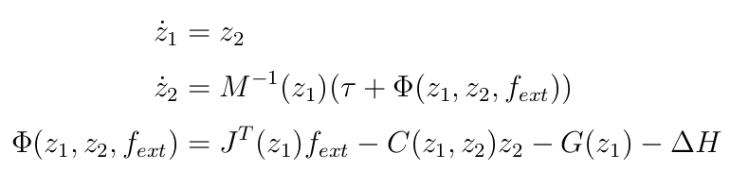
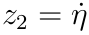
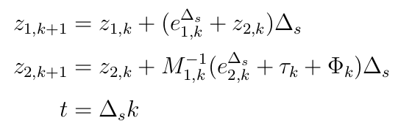
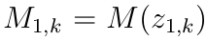
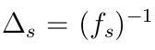
Dynamical Model, cont.

Slide 30
BlueFoot Simulator

Slide 31
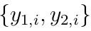
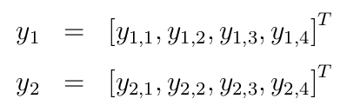
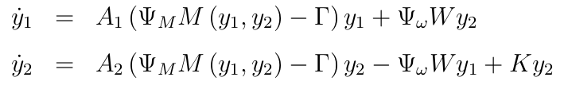
CPG with Hopf Unit Oscillators

Slide 32
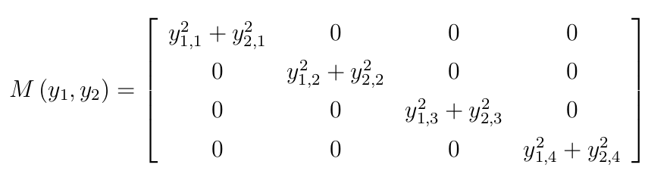
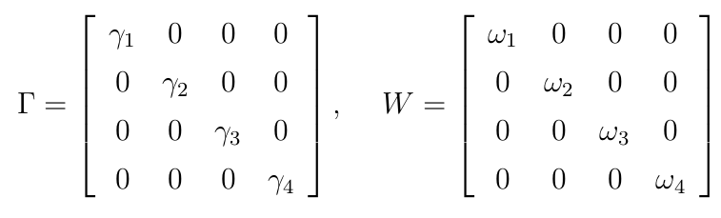
CPG with Hopf Unit Oscillators, cont.

Slide 33
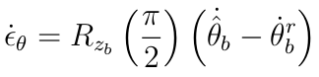
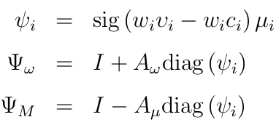
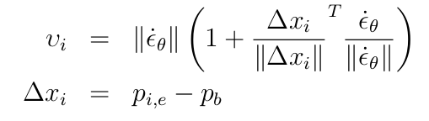
Reflexive CPG Design

Slide 34
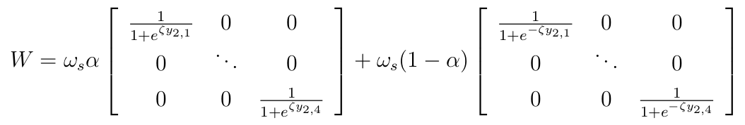

Reflexive CPG Design, cont.

Slide 35


CPG Gait/Coupling Design

Slide 36





Foothold Controller

Slide 37


ZMP Body-Placement Controller

Slide 38


ZMP Body-Placement Controller, cont.

Slide 39



ZMP Body-Placement Controller, cont.

Slide 40


NARX-NN Trunk Leveling Controller

Slide 41




NARX-NN Training Regimen

Slide 42


NARX-NN Training Regimen, cont.

Slide 43




NARX-NN Control Law

Slide 44


NARX-NN Control Law

Slide 45


Potential Fields

Slide 46


Potential Fields

Slide 47


Potential Fields

Slide 48


Potential Fields

Slide 49



Potential Fields

Slide 50

Potential Fields

Slide 51





Potential Fields

Slide 52





Potential Fields

Slide 53


Potential Fields

Slide 54


Potential Fields

Slide 55

Source Point Cloud (1)

Slide 56

Surface Normal Estimation (2)

Slide 57

Source Point Cloud (2)

Slide 58

Surface Normal Estimation (2)

Slide 59


